Slide 1
HEALTHCARE OF CALIFORNIA
Group 3
Shubham A. Deokar
Susum Nishad
Shilpi Goswami
S.N.K Sreenath V
Ankita Nyati
Yashwant P

Slide 2
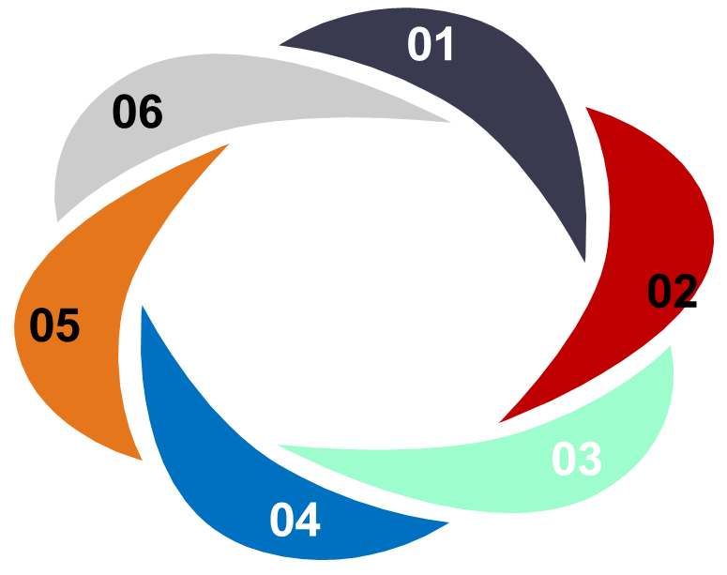

TABLE OF CONTENTS
INTRODUCTION
ALL KPI ANALYSIS AND CONCLUSIONS
DASHBOARDS
CONCLUSION

Slide 3
INTRODUCTION
What is Healthcare?
Health care is the process of improving health by preventing, diagnosing, treating, or curing illnesses, injuries, and other impairments.
It can also include cure of physical and mental impairments. Health care is provided by health professionals and allied health fields.
Importance of Healthcare.
Health care is conventionally regarded as an important determinant in promoting the general physical, mental and social well-being of people around the world and can contribute to a significant part of a country's economy, development and industrialization when efficient.
Brief note on project data.
From data sets of project we got four year of data which includes number of patience in both OP and IP with their over all stay in hospital depending on their area also net and gross expanses on hospital type.

Slide 4
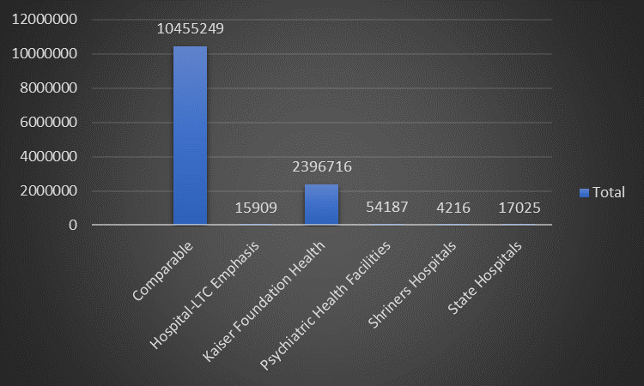
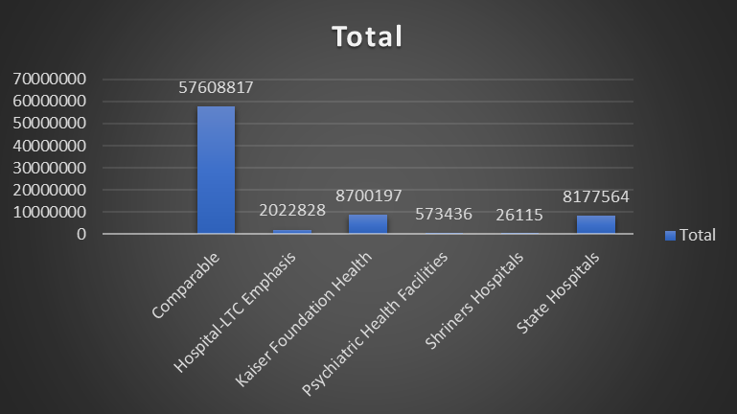
KPI 1 - Number of Total Discharge
KPI 2 - Number of Patients day
Conclusion:
Overall, the highest number of discharges is observed in the Comparable category, followed by Kaiser Foundation Health. This could indicate the volume of patient care or activity in these respective healthcare entities or categories. Further analysis may be required to understand the reasons behind these discharge numbers, such as patient demographics, types of services provided, or specific medical conditions treated.
Conclusion:
Overall, the highest number of days spent is observed in the Comparable category, indicating potentially longer stays or higher patient volume in these facilities. Kaiser Foundation Health also demonstrates a significant number of days spent, suggesting a substantial patient load. Further analysis may be required to understand the underlying reasons behind the variation in the number of days spent across different healthcare categories.

Slide 5
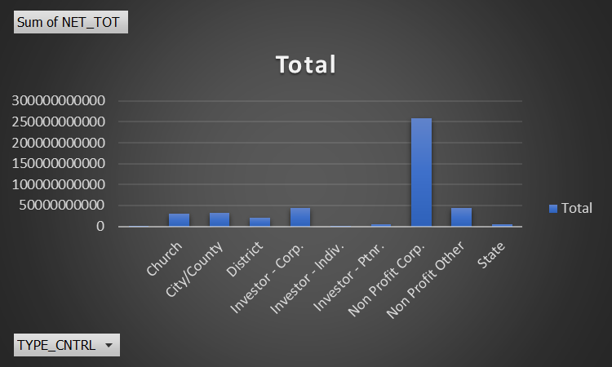
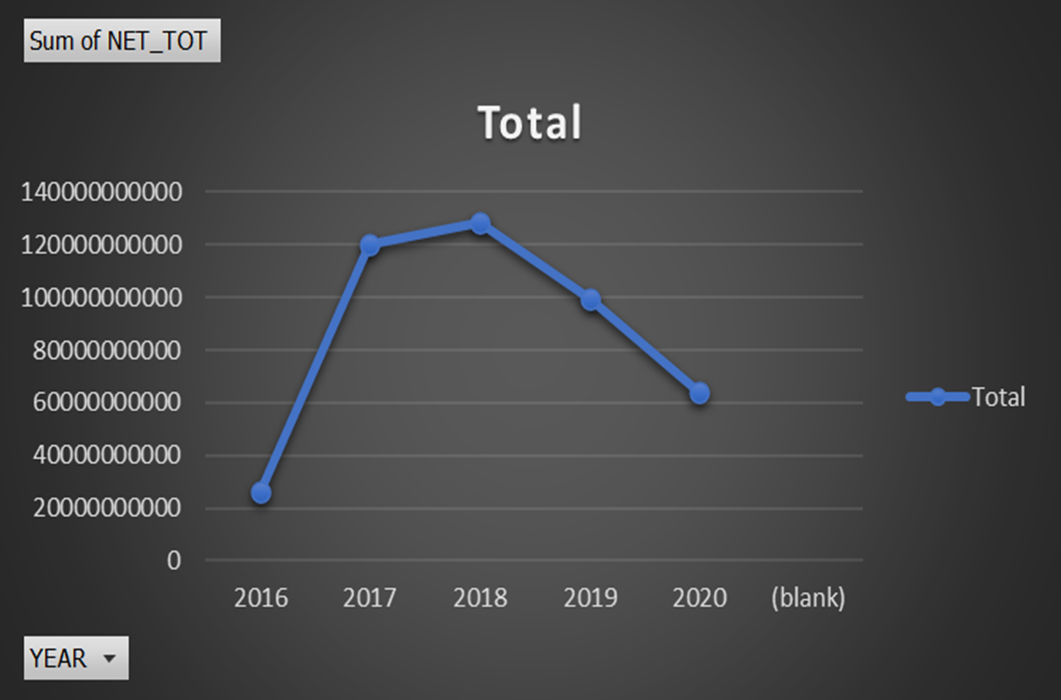
KPI 3 - Net Patients Revenue
KPI 4 - Revenue Trends
Conclusion:
Overall, non-profit corporations and city/county entities seem to be the largest contributors to net revenue, followed by corporate investors. Further analysis would be needed to understand the specific revenue sources and financial structures underlying these figures.
Conclusion:
These figures indicate fluctuations in net revenue over the years, with a peak in 2018 and a decrease in 2020. Further analysis may be required to understand the factors influencing these fluctuations, such as economic conditions, policy changes, or industry-specific factors.

Slide 6
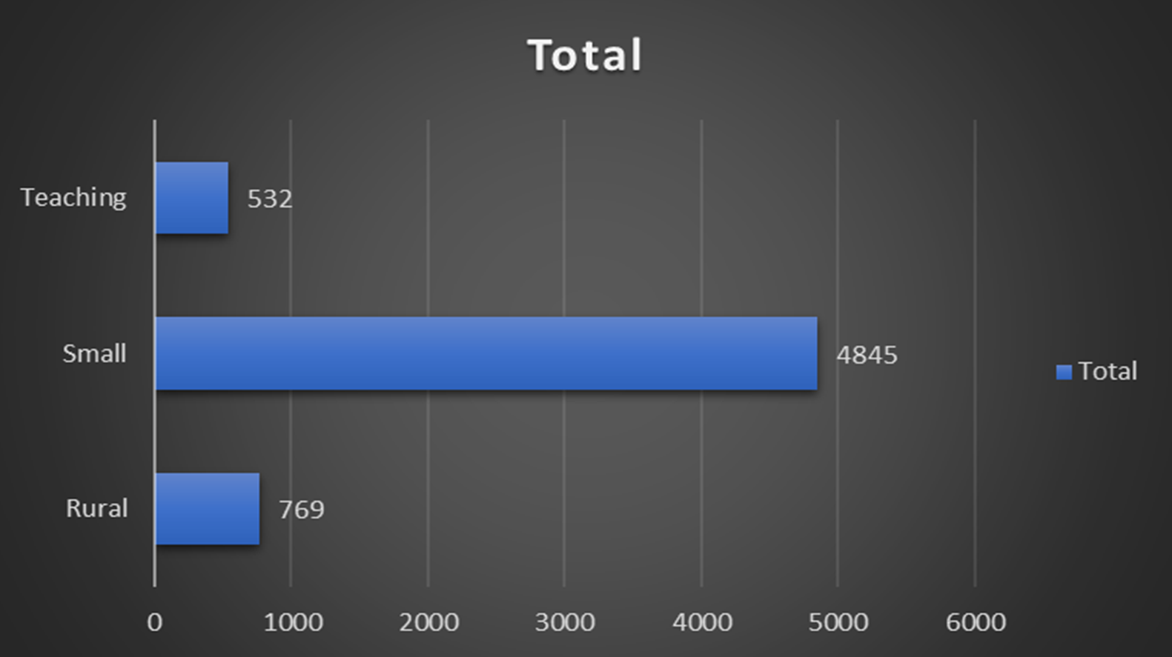
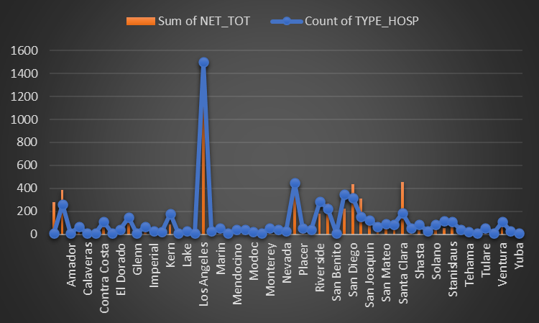
KPI 5 - Patients Stays
KPI 6 – State wise No. of Hospital
Conclusion:
This data provides insight into the distribution of patient stays across different types of healthcare facilities. Further analysis could explore factors contributing to the variation in patient stays between different facility types, such as location, services offered, or patient demographics.
Conclusion:
This data provides insight into the distribution of patient stays and net revenue across different regions or hospital types. Further analysis could explore trends, patterns, and factors influencing patient stays and revenue generation in each region or hospital type.

Slide 7
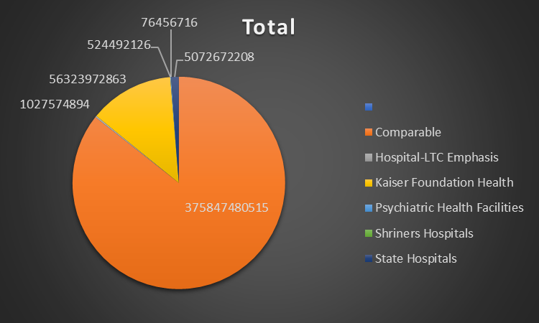
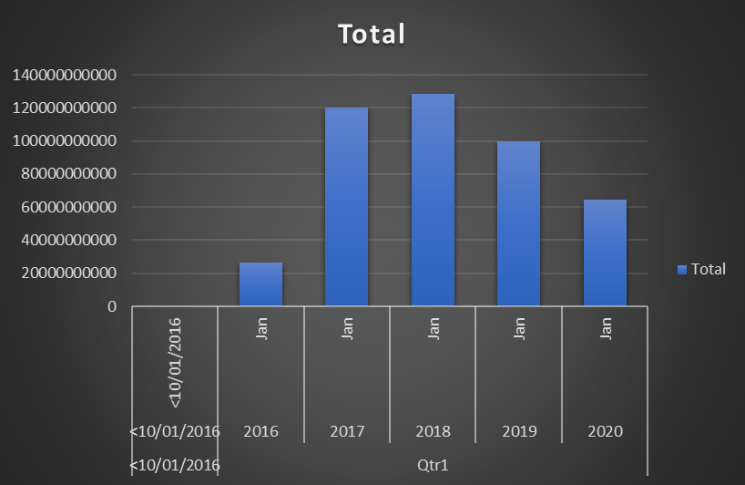
KPI 7 - Types of Hospital Revenue
KPI 8 - MTD/ YTD/ QTD Revenue
Conclusion:
This data provides insight into the distribution of net revenue across different types of healthcare entities, with some entities generating significantly higher revenue than others. Further analysis could explore the reasons behind these variations, such as patient volume, services provided, or geographic location.
Conclusion:
In conclusion, while there may be fluctuations in net revenue over time, the overall trend suggests positive growth and financial stability. Hospitals should remain vigilant, analyze key drivers of revenue performance, and implement strategic initiatives to sustain and enhance financial health in the dynamic healthcare landscape.

Slide 8
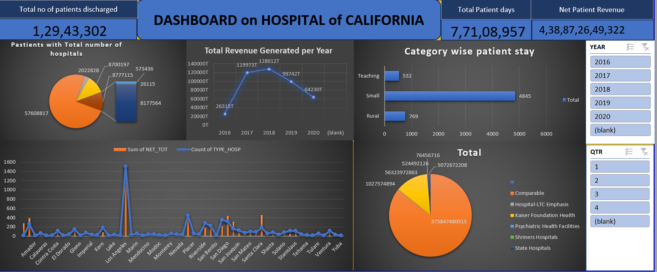
Excel Dashboard

Slide 9
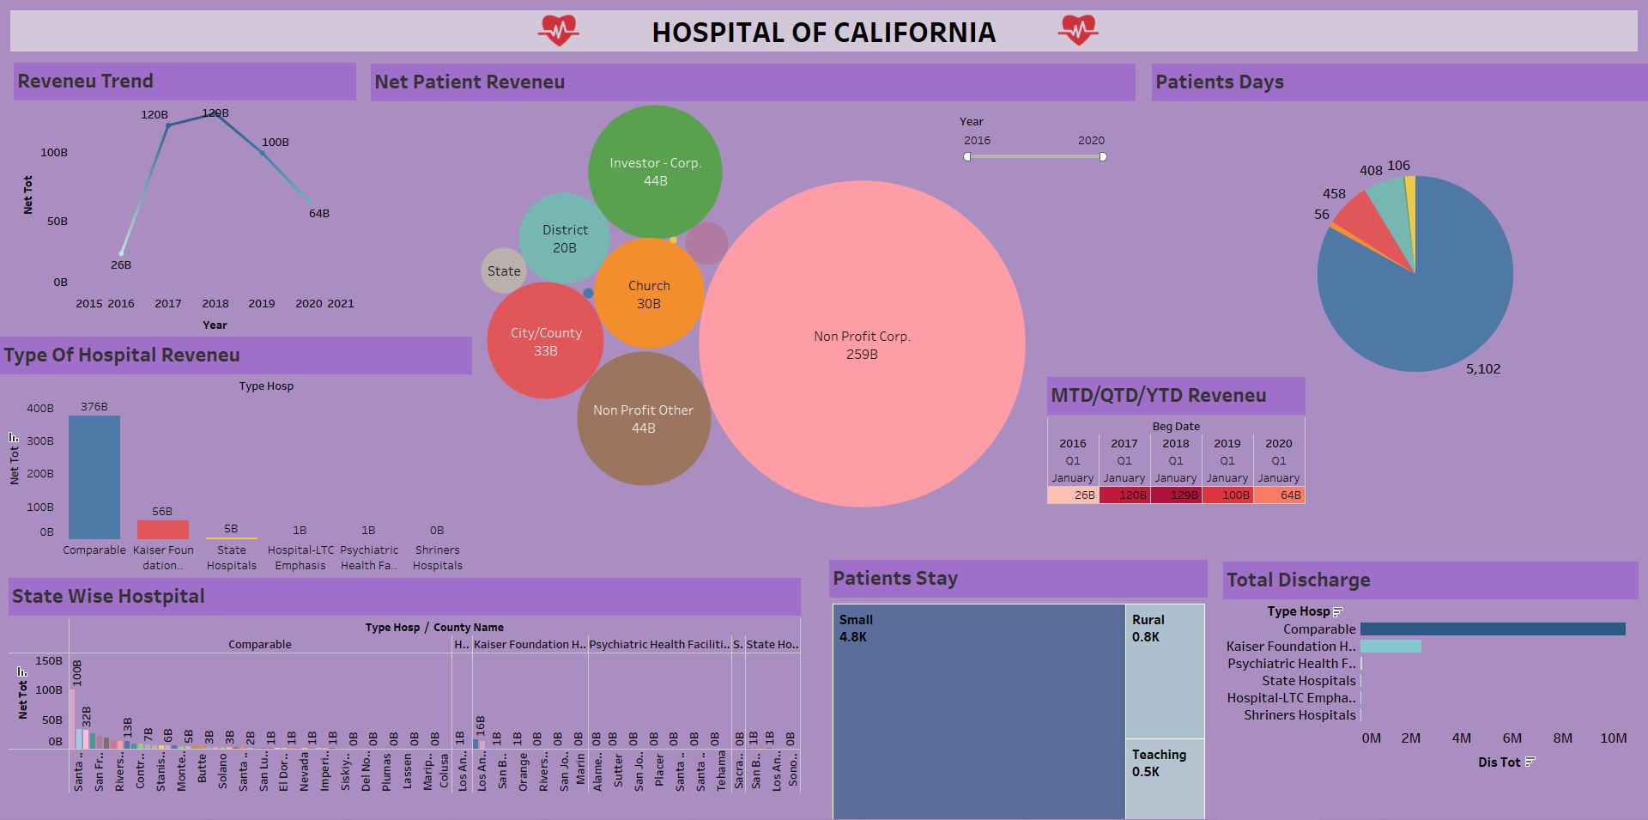
Tableau Dashboard

Slide 10
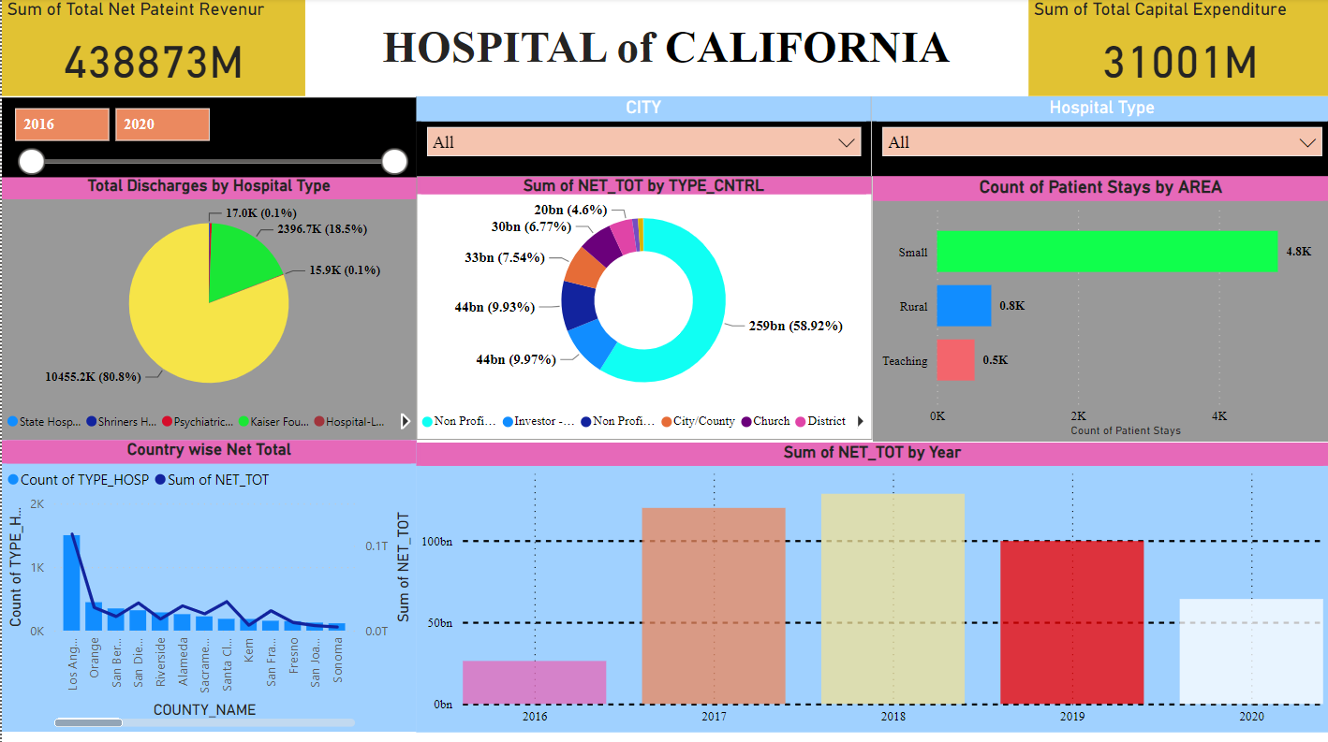
PowerBI Dashboard

Slide 11
RECOMMENDATIONS
Hospitals should analyse the revenue distribution across different types of entities and regions to identify areas for potential growth. This may involve focusing on partnerships with high-revenue-generating entities or expanding services in regions with high patient volumes.
Hospitals should strive to optimize operational efficiency to maximize revenue while minimizing costs. This could involve streamlining administrative processes, optimizing staffing levels, and investing in technology to improve patient care delivery.
Hospitals should consider diversifying their revenue sources to reduce dependency on a single entity or revenue stream. Exploring opportunities such as partnerships with non-profit organizations, government agencies, or private investors can help mitigate risks associated with fluctuations in revenue.
Hospitals should prioritize patient care and experience to attract and retain patients. This may involve investing in infrastructure improvements, enhancing clinical services, and implementing patient-centred care initiatives to ensure high-quality care delivery and patient satisfaction.
By implementing these recommendations, hospitals can strengthen their financial performance, enhance patient care delivery, and position themselves for long-term success in an evolving healthcare landscape.

Slide 12
CONCLUSION
Can improve patient safety by reducing medication errors, adverse drug reactions, and improving compliance to practice guidelines
Everyone needs to be well informed and concerned about the quality of care.
Over all checkups at minimal cost to attract more no of patients
Waiting time should be reduced on Ops.
The average net revenue for January shows an increasing trend from 2016 to 2019, with a slight decrease in 2020. However, specific revenue trends for other periods or quarters are not provided.
Comparable healthcare entities have the highest number of discharges and days spent, indicating potentially higher patient volumes or longer stays compared to other categories.
Overall, the data suggests a complex landscape of healthcare provision, with significant variation in patient stays, revenue generation, and resource utilization across different types of facilities, regions, and over time. Further analysis and contextual information would be needed to fully understand the factors driving these variations and trends in the healthcare system.

Slide 13
THANK YOU

